Slide 1
D Bauer, R Bonvin, J Breckwoldt, H Bruppacher, M Monti, S Wüst, M Germano, K Schnabel
Hybrid Simulations for the assessment of Swiss medical students’ clinical skills
17.03.2017, SPSim

Slide 2
Agenda
Part I
Hybrid simulations in D/A/CH undergraduate programs
Report & discussion
Part II
Mock hybrid OSCE
Experience & discussion

Slide 3
Background
Quality assurance project BAG
2016-2017, Bern, Lausanne, Zurich
Goal: recommendations towards the use of hybrid simulation in the clinical skills segment of the Swiss medical licensing exam
Phase I: collection of evidence and experiences
Phase II: pilot testing of refined hybrid OSCE stations

Slide 4
Simulation
... imitates but does not duplicate reality .
Christine McGuire, 1999
Protecting real patients
Protecting future patients
Standardisable and calculable
Tekian A, McGaghie WC, McGuire CH. Innovative simulations for assessing professional competence: From paper-and-pencil to virtual reality. Chicago: University of Illinois at Chicago, Department of Medical Education; 1999.
Miller GE. The assessment of clinical skills/competence/performance. Academic medicine. 1990;65(9):S63-7.

Slide 5
Fidelity
Fidelity Framework
Patient
Healthcare facilities
Clinical scenario
Validity
Validity argument strengthened with simulation fidelity
Tun JK, Alinier G, Tang J, Kneebone RL. Redefining Simulation Fidelity for Healthcare Education. Simulation & Gaming. 2015;46(2):159-74.

Slide 6
Standardized Patients
Can simulate (well)
Patient history
Emotions, moods
Limited mobility
Limited sight
Pain (some)
Reflexes (some)
...
Cannot simulate (so well)
Auscultation findings
Heart, lung, abdomen
Palpation findings
Abdomen, joints, fractures
Skin lesions
Mucosal lesions
Oral, genital
…

Slide 7
Hybrid Simulation
Multiple modalities: SP + X
Integration technical and non-technical skills
Advantages
Assessment of findings that cannot be simulated
Less change of medium
Less examiner-examinee interaction
Adds to validity argument

Slide 8
“What I did last summer...”
Gather info:
Literature search
Simulatorennetzwerk database
Semi-structured interviews with simulation centres
Experts/ vendors’ catalogues/ industrial fairs
Matching of hybrid scenarios with SCLO
Focus on summative assessment
Damanakis A, Blaum WE, Stosch C, Lauener H, Richter S, Schnabel KP. Simulator Network Project Report: A tool for improvement of teaching materials and targeted resource usage in Skills Labs. GMS Zeitschrift fur medizinische Ausbildung. 2013;30(1)

Slide 9
Examples: summative assessment
Strap on breasts
Variation: changed padding & added paint to simulate mastitis
Gynaecological teaching assistants only in teaching
Image source: https://www.erler-zimmer.de/media/image/95/99/15/L62_600x600.jpg

Slide 10
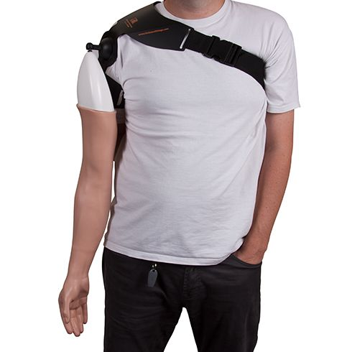
Examples: summative assessment
Venepuncture
Arm or pad affixed to SP, transition zone covered with cloth
In teaching also
Image source: https://assets.limbsandthings.com/products/00300.jpg

Slide 11
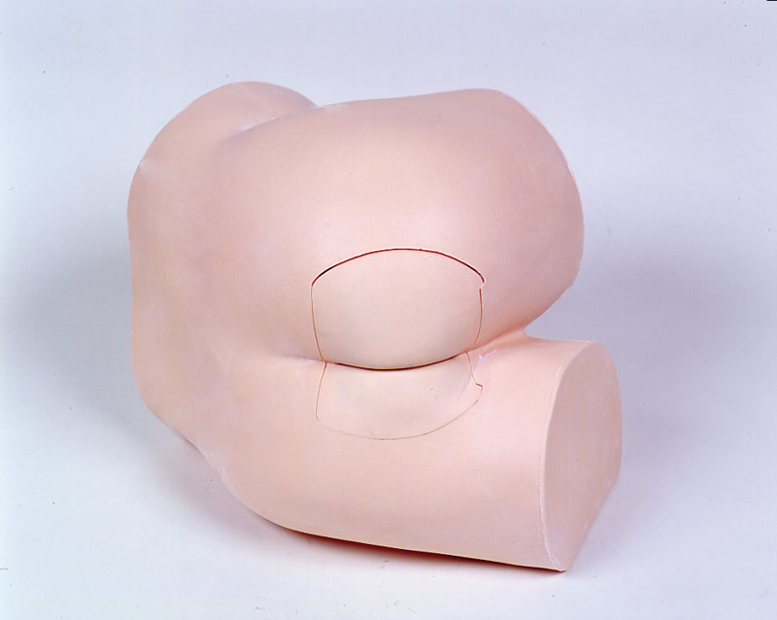
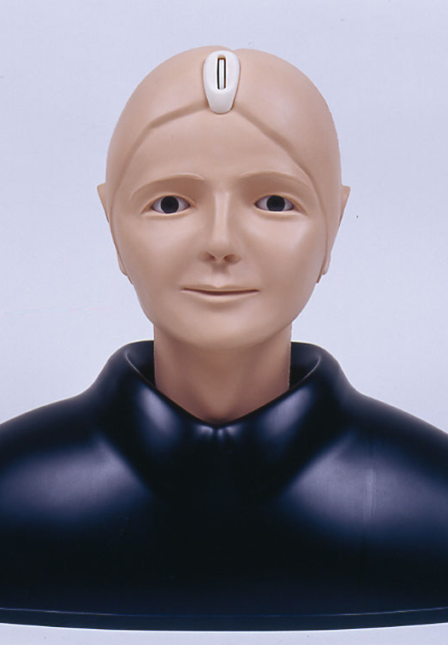
Examples: summative assessment
SP combined with simulator
Variations in positioning
Rectal exam, gynaecologic exam, funduscopy, otoscopy, catheterization…
Professional teaching assistants in teaching
Change of medium
Image sources:
https://www.erler-zimmer.de/media/image/73/23/8a/R16240_3580e71568a424.jpg
http://www.globalnasco.com/prod/images/products/86/AC071441l.jpg
https://www.erler-zimmer.de/media/image/a6/a7/7f/R16100580e714c5519a.jpg

Slide 12
Examples: summative assessment
Manikin with Makeup
Rigged paediatric manikin: unilateral chest excursion (simulating object aspiration); SP as parent
Image source: http://cdn3.volusion.com/nqpvm.detql/v/vspfiles/photos/AB256-001-2.jpg?1474372745

Slide 13
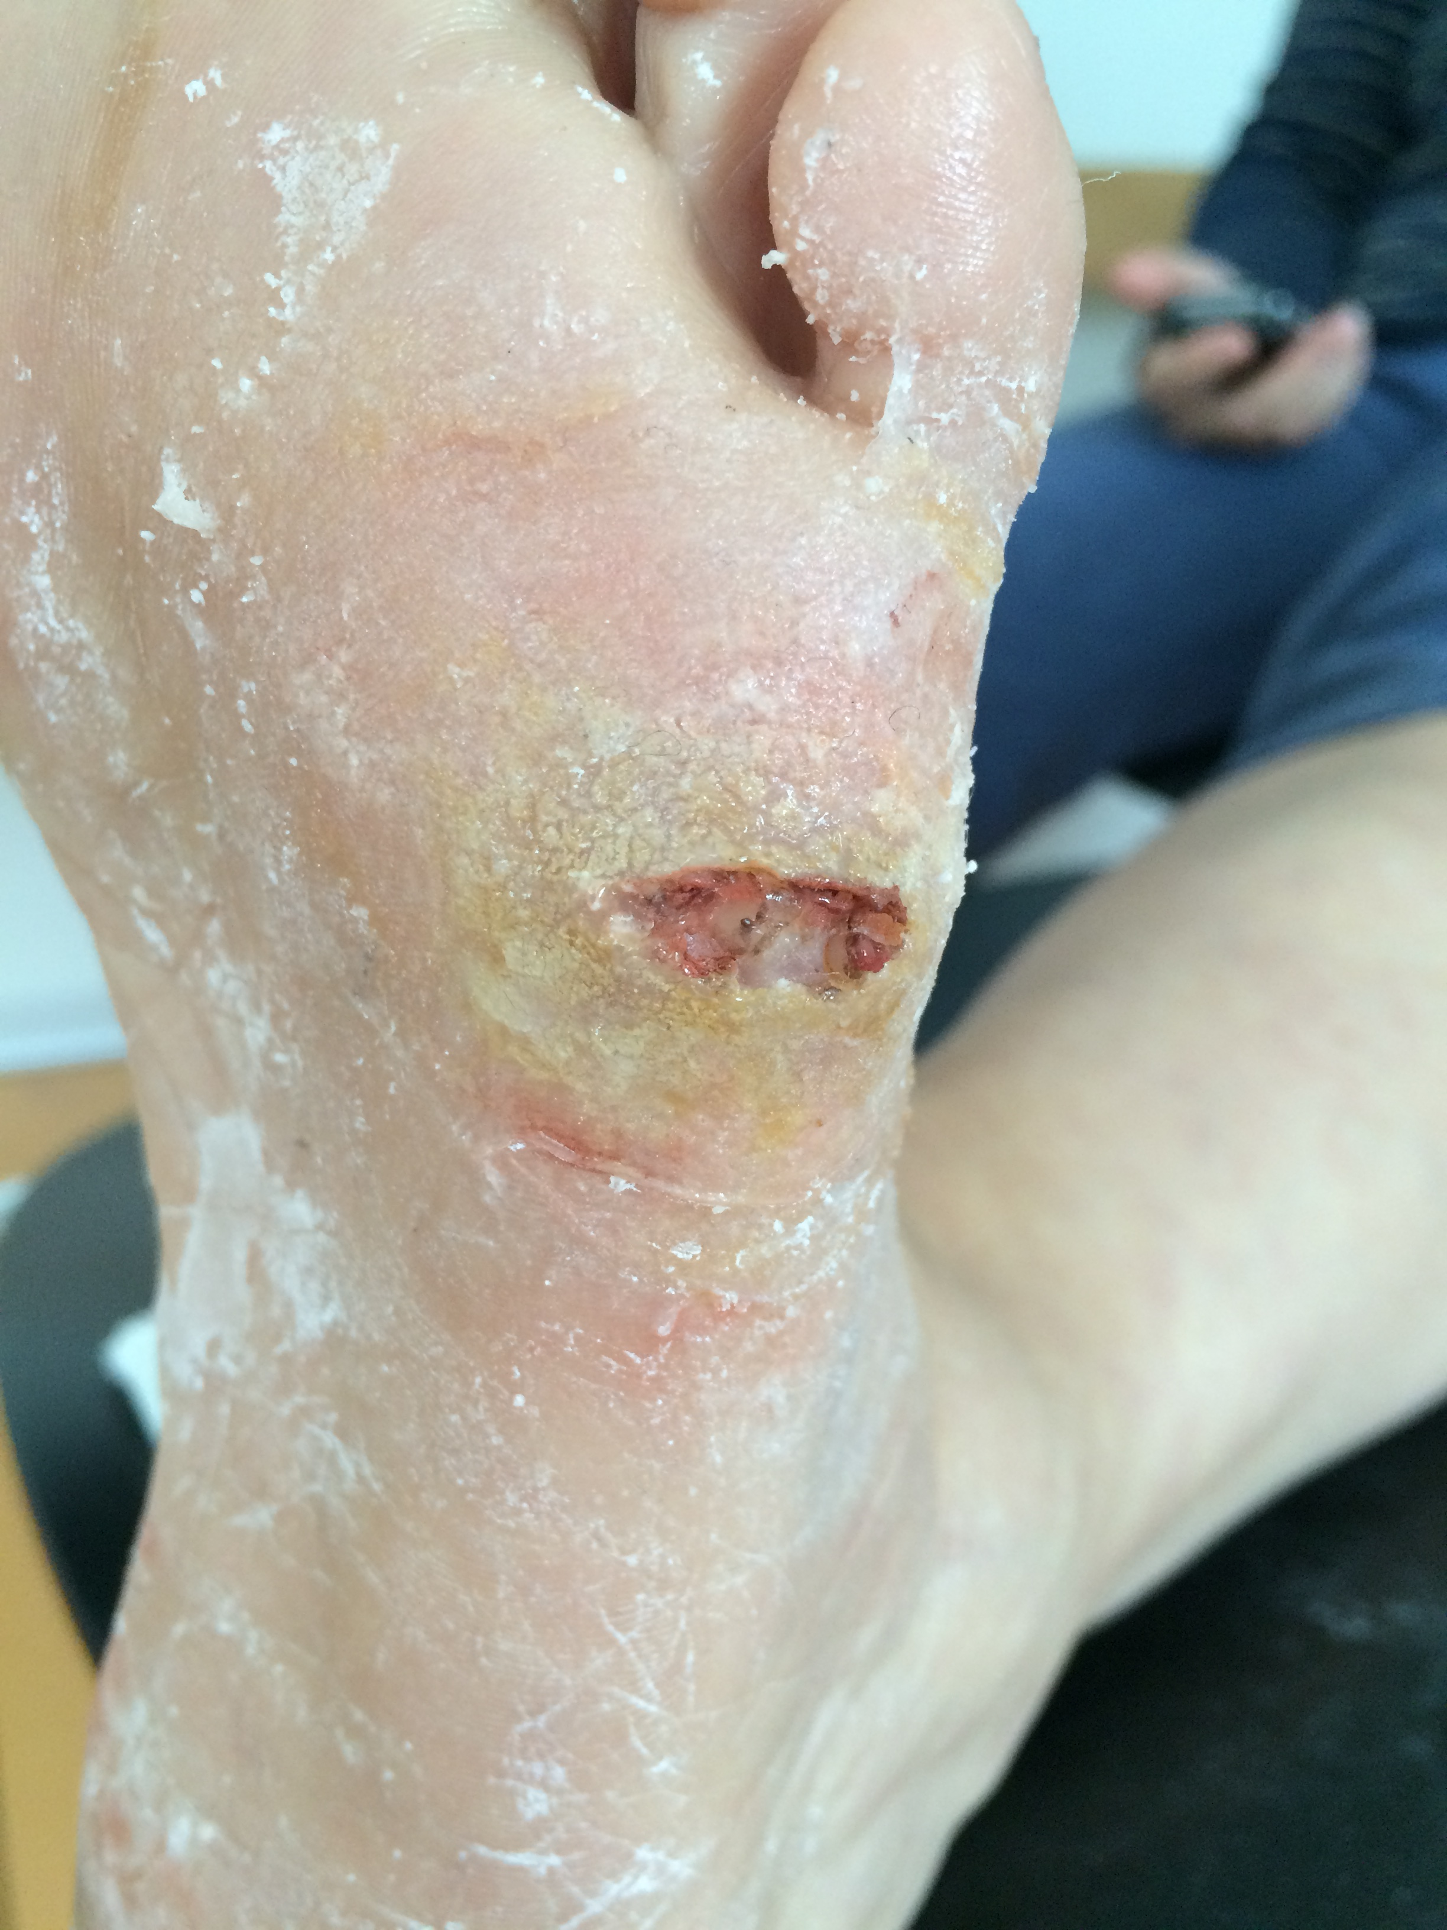
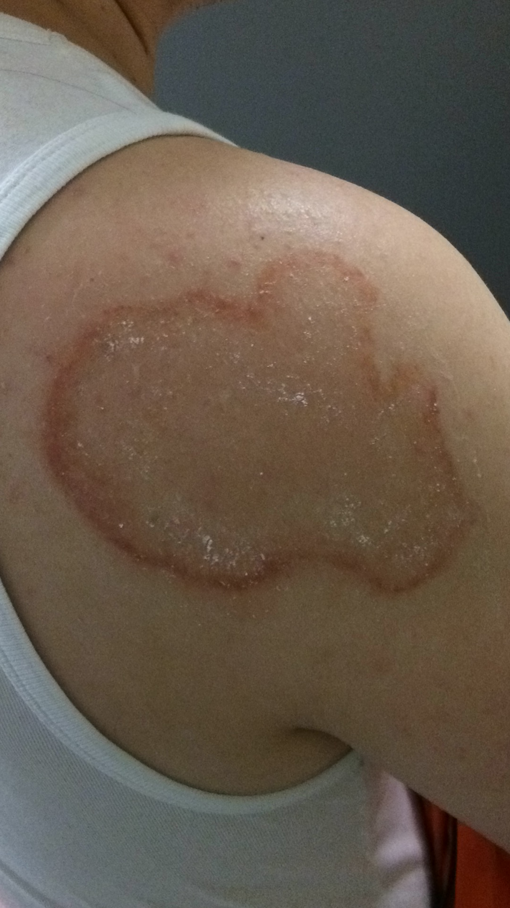
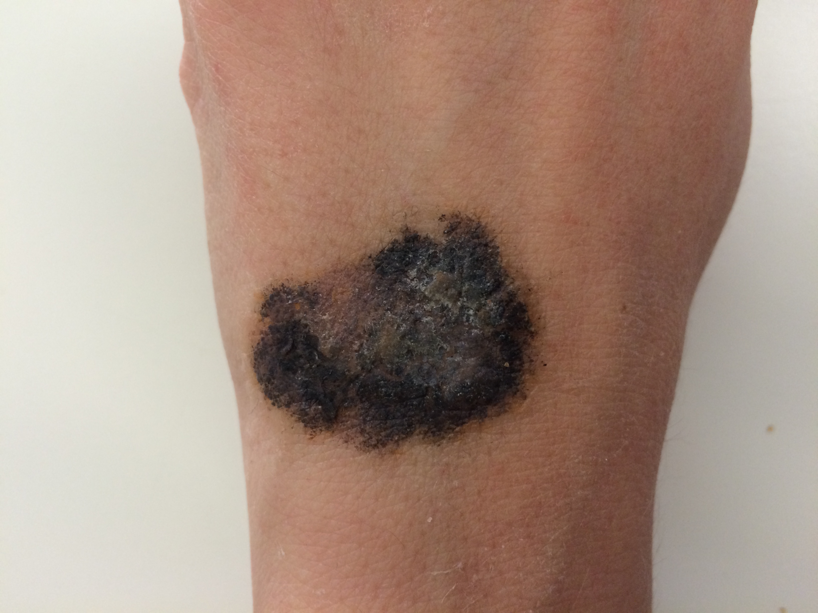
Examples: summative assessment
Use of make-up, moulage and transfer tattoos
Swiss-wide
3D technology (trials)
Image source: IML

Slide 14
Examples: teaching only
Manikin with make-up
Rigged paediatric manikin: red spots (simulating petechial haemorrhages); SP as parent
Image source: http://cdn3.volusion.com/nqpvm.detql/v/vspfiles/photos/AB256-001-2.jpg?1474372745

Slide 15
Examples: teaching only
Friederichs H. Die Kombination von Simulationspatienten und Simulatoren: Hybrid-Modelle in der Lehre der Herzauskultation – Studien zur Selbsteinschätzung und zur Performance von Studierenden. Heidelberg: Ruprecht-Karls-Universität; 2012.
Friederichs H, Weissenstein A, Ligges S, Möller D, Becker JC, Marschall B. Combining simulated patients and simulators: pilot study of hybrid simulation in teaching cardiac auscultation. Advances in physiology education. 2014;38(4):343-7.

Slide 16
Examples: teaching only
“Ventriloscope”
One pilot in teaching
Variations: heart monitor, “classic” or “live”
Remote controlled, wireless
“Live”: real stethoscope & receiver/ speaker
Image source: https://www.samuelmerritt.edu/images/hssc/ventriloscope_450x450.jpg

Slide 17
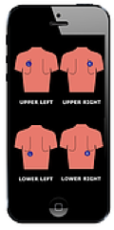
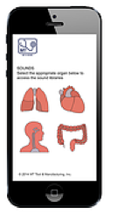
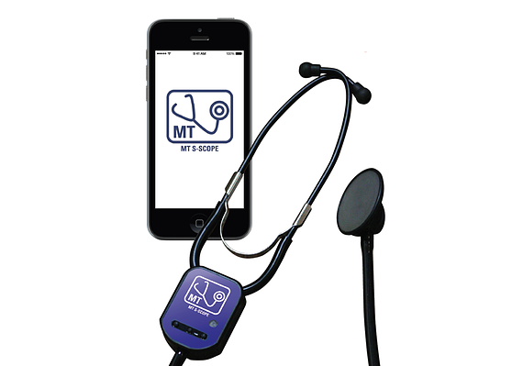
No report of use
App on iOS device
Wireless remote control
Patient scenarios
No stethoscope function
Image sources
https://www.mttool.com/about-ccjb
https://www.mttool.com/project

Slide 18
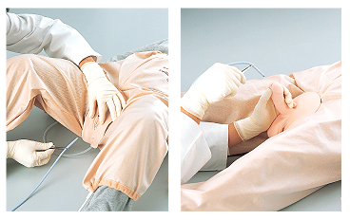
No report of use
Catheterization
No report of use, hybrids available
Image sources
http://www.sakamoto-model.com/product/nursing/m180/
https://www.erler-zimmer.de/media/image/f6/7b/d9/LM25_1580e6de34cee8_600x600.jpg

Slide 19
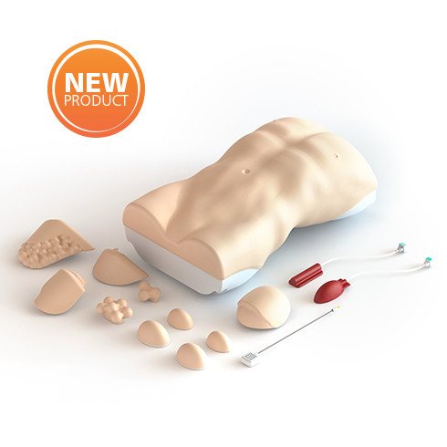
No report of use
Abdominal palpation
Combine with SP?
Image sources
http://en.honglian8.com/products/Products-436.html
https://www.limbsandthings.com/global/our-products/details/abdominal-examination-trainer

Slide 20
Tentative summary
Different grades of hybridization
Change of medium is common
SP for communication, simulator for objective findings
Few examples from summative assessment
Other examples?
Your views?

Slide 21
Near future
Pilot studies with simulation stethoscopes, fat suits, moulages (applied to manikins), abdominal palpation trainers…
Feasibility, acceptance, psychometric non inferiority, added value
This brings us to the very near future: Part II
The Mock OSCE!

Slide 22
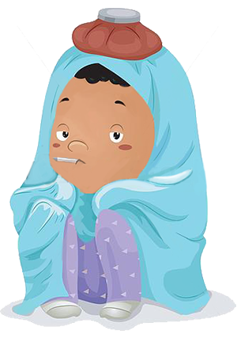
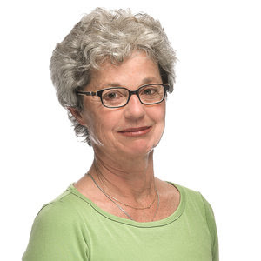
Mock OSCE
Fever, cough
Motivational talk
Skin condition
Image sources: IML
https://lh6.googleusercontent.com/proxy/1F-SK3zACPqJ1RWnquCT6Celg1HASYqzpcwN2eIHErGQSdMAidDk4x7s_ILsai3o-NQWm5dHB_hJg1P9ezAEmIHARnTsD57Qq6uQQ_J6qrmLKzF1=w300-h427-nc http://vignette4.wikia.nocookie.net/hulk/images/3/3a/HulkSmash.jpg/revision/latest?cb=20130303011408

Slide 23
Mock OSCE
3 stations
1 volunteer SP (script provided)
3 volunteer examinees (medical lay knowledge is fine)
3 volunteer examiners (electr. documentation system provided)
Timing
5 minutes preparation
3 x 10 minutes exam
Discuss

Slide 24
Last Slide: Discussion
Which observations would you like to share regarding hybrid simulation?
What potential, which challenges do you see?

Slide 25
That‘s all, folks!
Danke für Ihre Aufmerksamkeit!

